Slide 1
IPUMS National Health Interview Survey (NHIS) DATA ANALYSIS

Slide 2
Introduction:
The National Health Interview Survey (NHIS) is a comprehensive survey that gathers data on the health, healthcare access, and health behaviors of the U.S. population. The IPUMS NHIS dataset contains a wide range of information, including self-reported health conditions, acute and chronic illnesses, functional limitations, healthcare utilization, behaviors like physical activity and diet, insurance coverage, demographics, immunization rates, mental health, prescription drug usage, reproductive health, healthcare spending, environmental/occupational exposures, and challenges in accessing medical care.

Slide 3
About Project- Analysis of NHIS Injury Records(2010-2017)
Data collection- The data, spanning from 2010 to 2017, was extracted from the IPUMS NHIS.
Objective- The primary objective of this data extraction was to analyze trends in the occurrence of falls and associated injuries within different age categories.
Aim- Our analysis specifically focuses on differentiating these trends among various age groups and genders to understand the patterns and causes of injury over the age of 55.

Slide 4
Team members
Hari Shivani- Developing Lead
Navya Reddy- Project manager
Mokshitha- PM Buddy

Slide 5
Achievements
Data extracted in Jupyter
Checked for null values
Data analysis (in progress): Utilized weighted averages to analyze injury counts, specifically examining how falls occurred (IRFALL1) and their causes (IRFALLWHY). Focused the analysis on age categories: 55-64, 65-84, and 85+.

Slide 6
Plan (phase 1)
1. Set project objectives and goals.
2. Create a team
3. Identify stakeholders

Slide 7
Plan (phase 2)
4. Data extraction –
Data extraction in our project involved gathering relevant information from the IPUMS NHIS website (https://nhis.ipums.org/nhis). We retrieved data from this source to use in our analysis. The transformed data was saved in a Jupyter file for further examination and insights. This extraction and transformation process allowed us to work with the data efficiently and perform meaningful analysis to achieve our project goals.
5. Data cleaning –
We meticulously checked for null values within our dataset and took the necessary actions to address them. This often involved removing records with missing data, ensuring that our analysis was based on complete and reliable information.
Notably, null values were observed in the COVID-related data. This was attributed to the fact that the dataset only extended up until 2017, and, as a result, did not contain information beyond that year.

Slide 8
Plan (phase 2)
Data analysis –
We examined the dataset in depth to find important patterns and trends about falls and injuries, paying special attention to age and gender breakdowns.
Three age groups were established: 55-64, 65-84, and 85+. We were able to examine and contrast fall counts within these age groups between 2010 and 2017 because to this categorization.
We computed the weighted average of fall counts across age groups in order to obtain a more thorough insight. We were able to take into consideration differences in population sizes within each category by using this method.

Slide 9
Plan (phase 3)
7. Interpret and summarise results
8. Create presentation to Communicate Results.

Slide 10
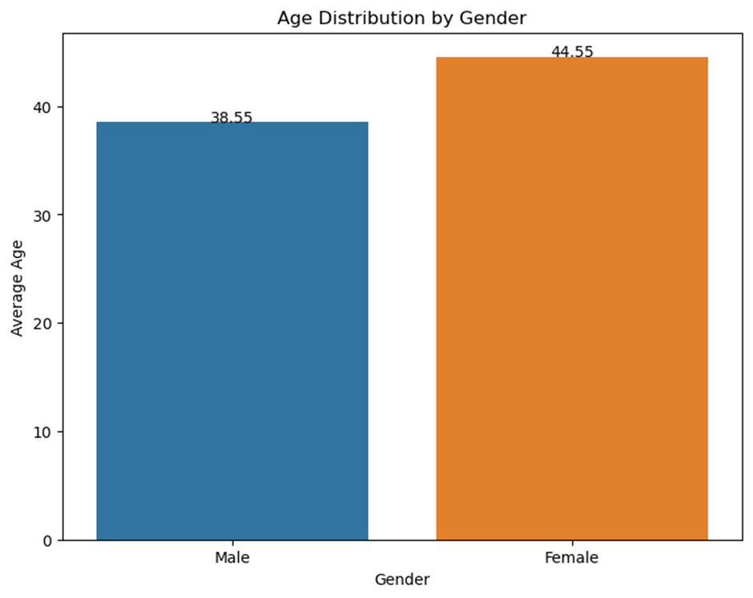
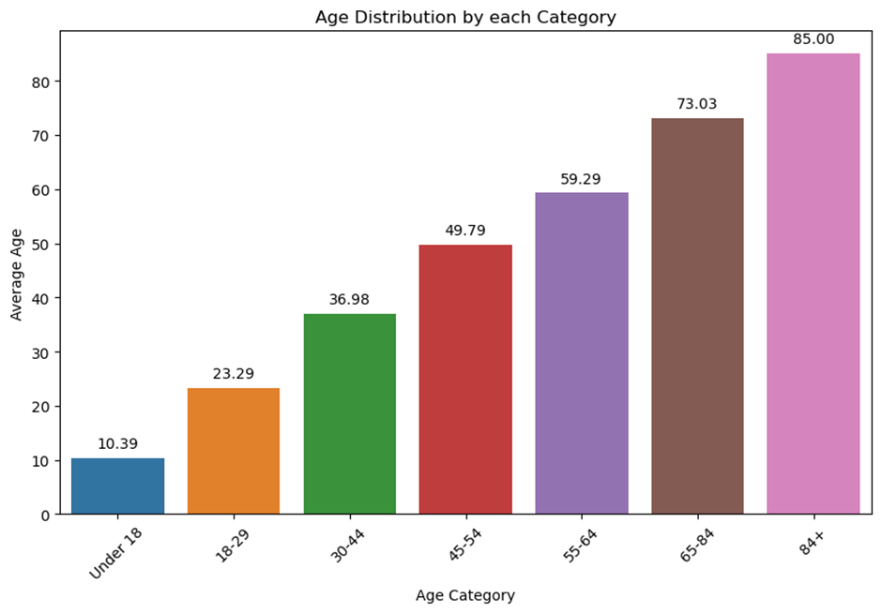

Slide 11
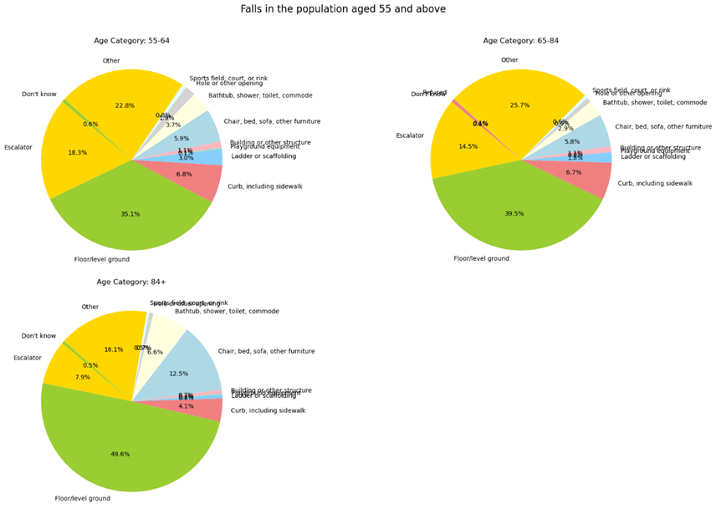
People over the age of 55 fell or were injured on the floor or an escalator

Slide 12
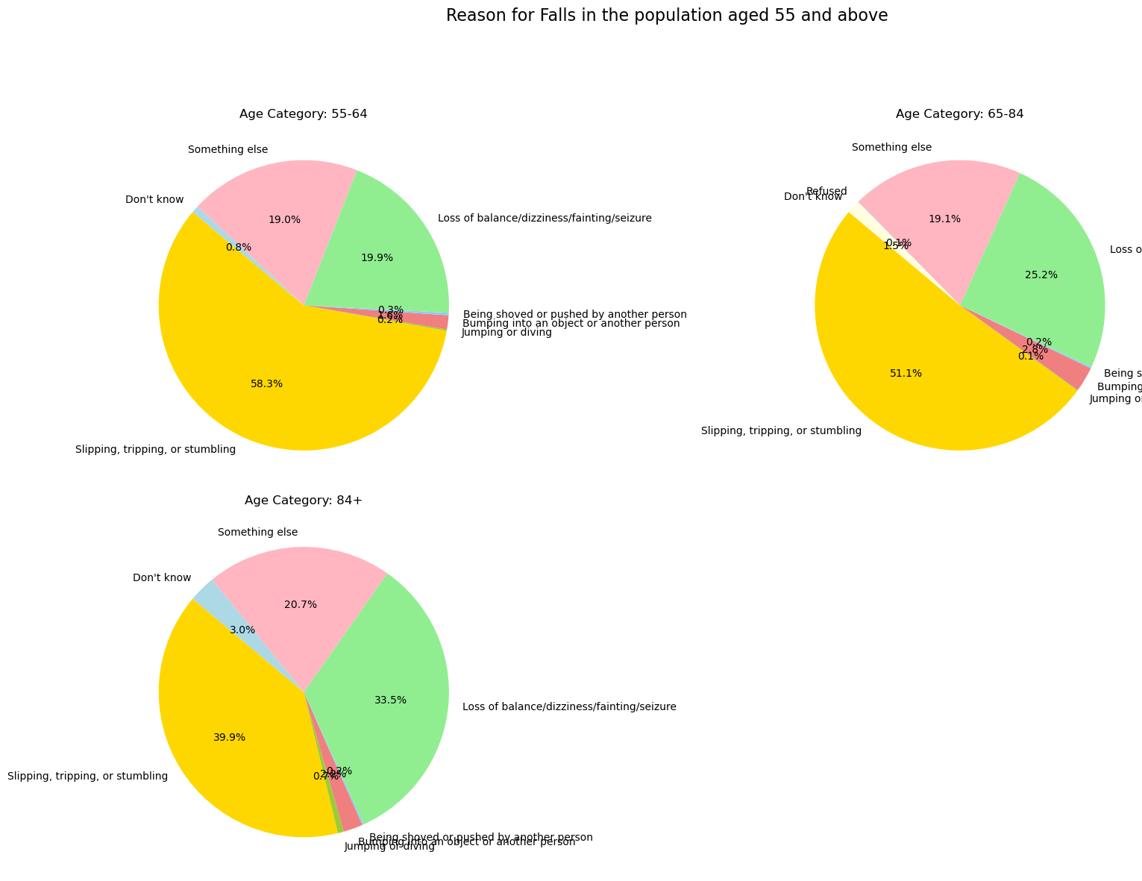
Slipping, tripping, and loss of balance are the most common causes of falls or injuries in people over the age of 55.

Slide 13
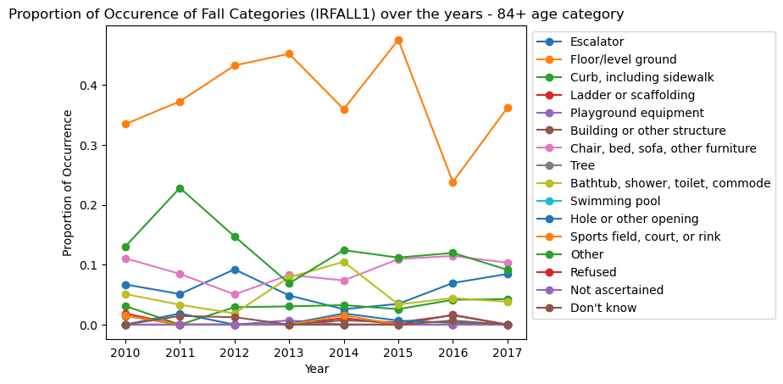
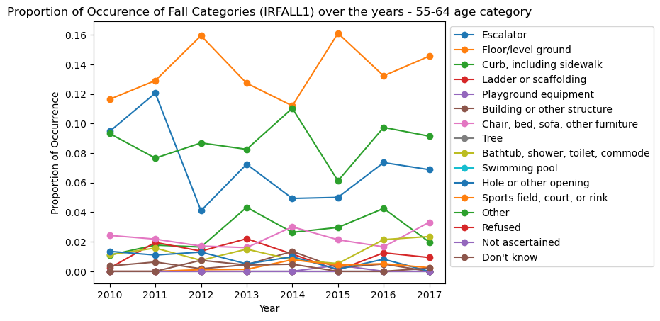
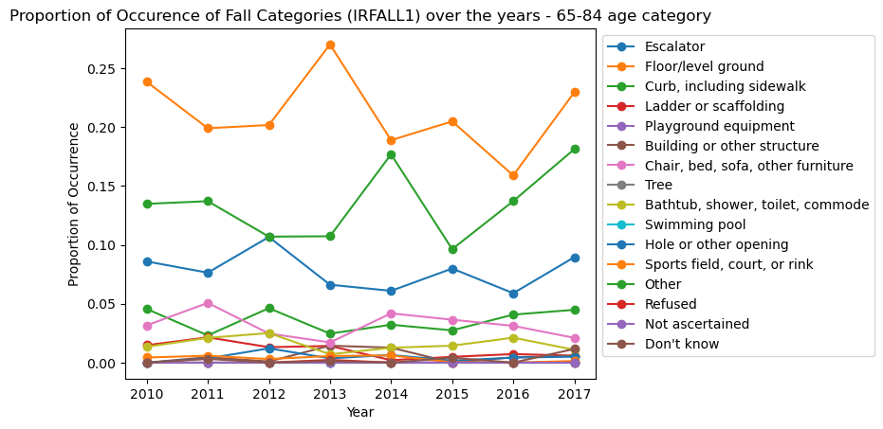
Falls caused by furniture and the ground/floor have increased in people aged 55 to 64. This shows that a greater emphasis on furniture safety and decreasing tripping hazards on floors could be beneficial.
Ground/floor falls consistently accounted for the largest proportion of falls among those aged 65-84 and 84+. This highlights the importance of ground and floor surfaces in adult fall prevention.

Slide 14
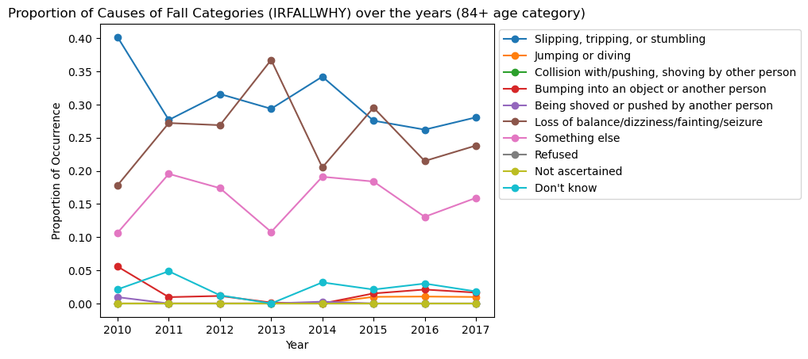
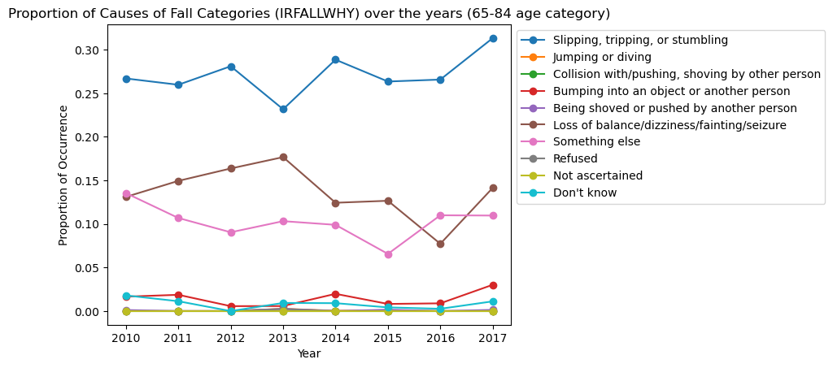
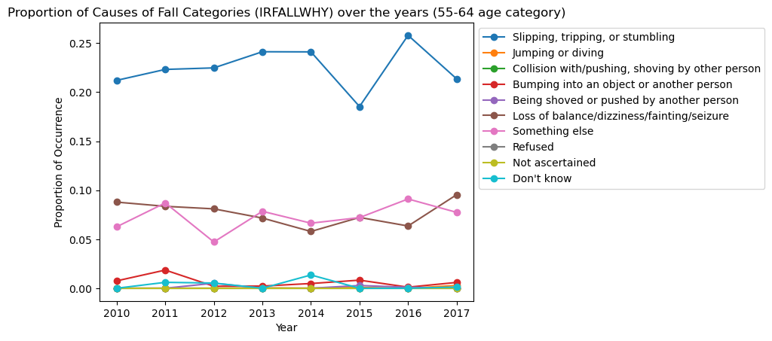
For all senior age groups, loss of balance and tripping/slipping were consistently the top reasons over the years. This highlights that improving balance and stability should be a primary focus for reducing falls in the senior population

Slide 15
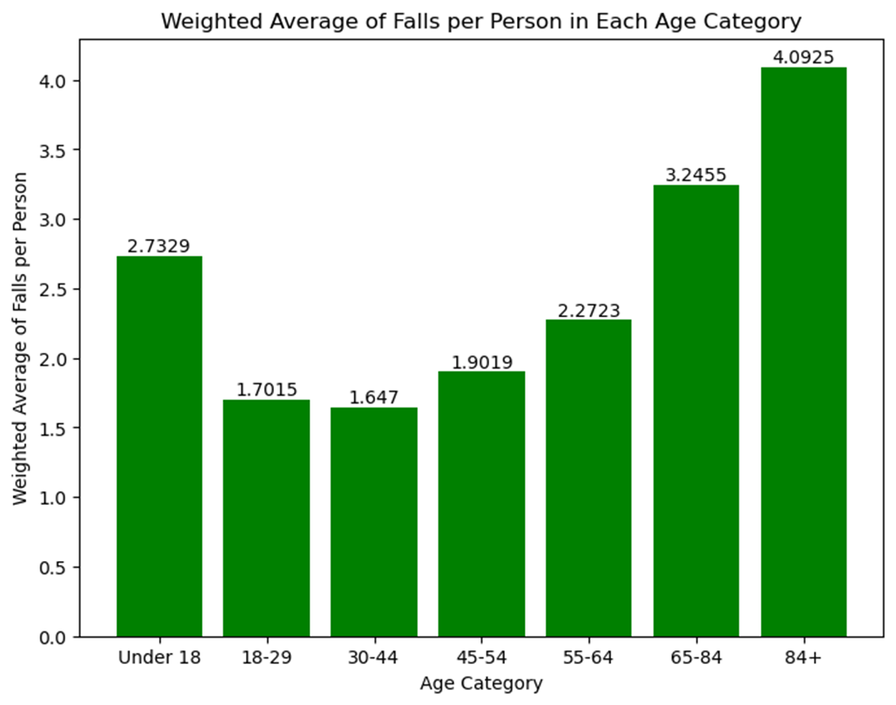
the rate of falls per person increases with age
"65-84" and "84+"-higher rates of falls per person
elders are more susceptible to falls

Slide 16
challenges
Initial Download Issue: Initially encountered difficulties when attempting to download the dataset.
The dataset lacks COVID-related information, with data available only up to 2017.

Slide 17

QUESTIONS??

Slide 18

THANK YOU

